Slide 1
User data management by tabs during a browsing session
Kapil Kumar
Joy Bose
(Web Solutions)
Samsung R&D Institute, Bangalore

Slide 2
Outline of Talk
Problem statement
Proposed Solution
Implementation Details
Experiments and Results
Conclusion

Slide 3
Problem Statement
Most modern web browsers are multi tabbed, with each tab corresponding to a separate browsing context. However, browser stores the history, favorites, cookies etc together for all the tabs
Therefore it becomes difficult for the user to track the individual tab contexts separately, and remove if necessary

Slide 4
Proposed Solution
Maintain browser data mapping with tab context while saving to persistent storage for current browser session.

Slide 5
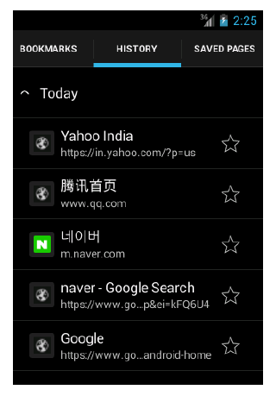
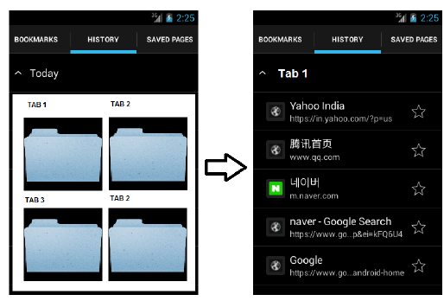
Existing vs Proposed Solution

Slide 6
Implementation method
Illustrated in the following flowcharts:
Representation of main flow for a browser storing user history in
browser database data by tab context.
Representation of main flow for managing user history data by tab
context by user.
Representation of main flow for a toggling mode of a browser tab
from normal to Incognito and vice versa

Slide 7
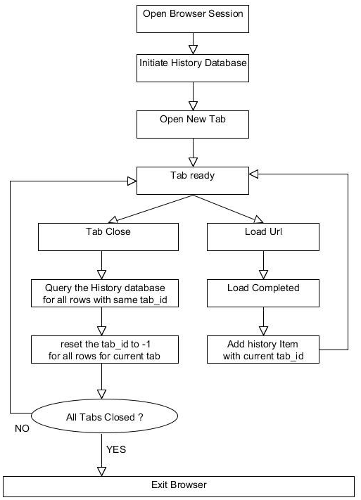

Slide 8
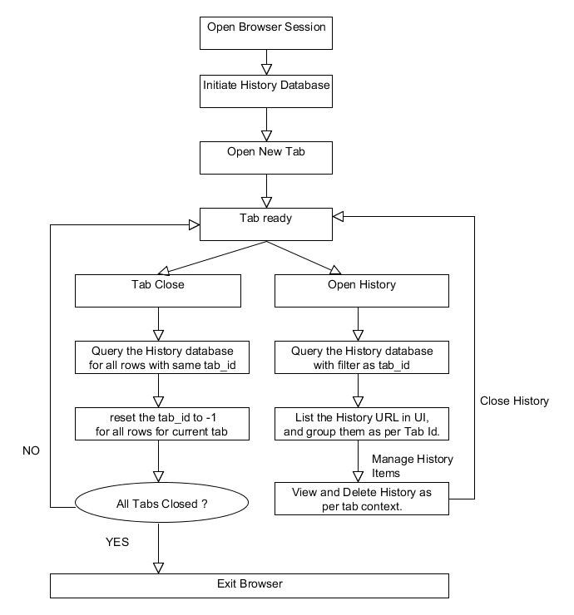

Slide 9
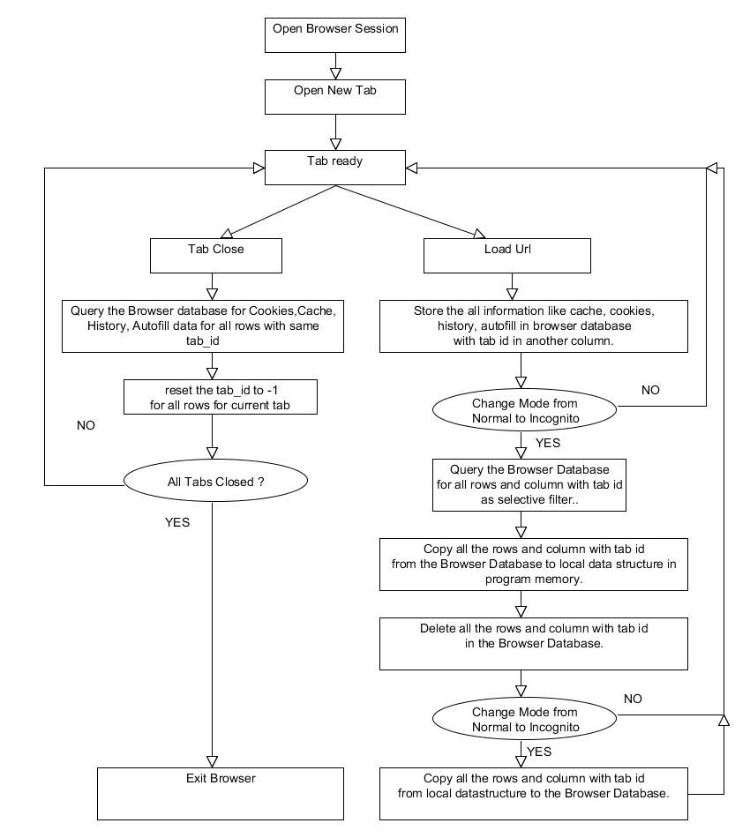

Slide 10
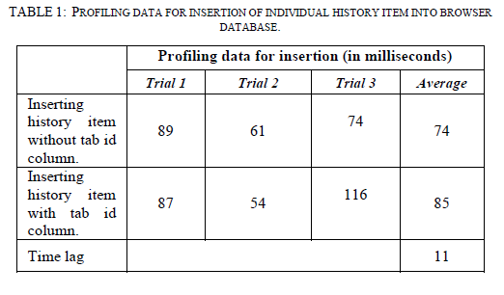
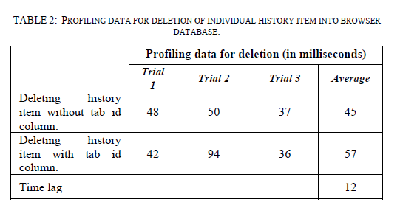
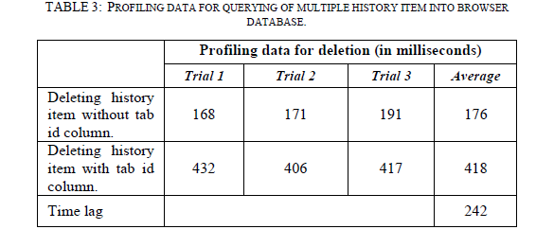
Experimental results –Profiling data

Slide 11
Conclusion.

Slide 12
Any Question ?? Thank You ☺

